Slide 1


Gradient coil simulation updates
ASHWINI KUMNOOR
RESEARCH ASSISTANT
Medical Imaging Research Center , DSI
Date-18/05/2017

Slide 2
Code from thesis
Single .m script: takes field strength, region of interest and coil geometry as input.
Does not use any special functions or models (like thikonovs model used in open source code)
Gives Desired field, Current density, Stream function, current, wire pattern as output.
Using this wire pattern actual field is also calculated.
Our requirement: To solve the cost function we get target and actual field, we need to calculate energy and torque experienced by the coil
Changes to be done: Give our Mesh as input and reproduce the results. (Plan is to first generate the same mesh in comsol and give as input)

Slide 3
Outputs of thesis code
Apodize (filter) the frequency space of target field to remove high spatial
frequency component resulting physically realizable current density
The solid lines are the desired field before apodization and the dashed lines show after apodization

Slide 4
X and z Current density
Current densities producing the target field. The x component (left) and z
component (right) of the current densities at the y = ±4 cm planes which generate the
desired (target) z-directed magnetic field at the y = 0.1 mm plane.

Slide 5
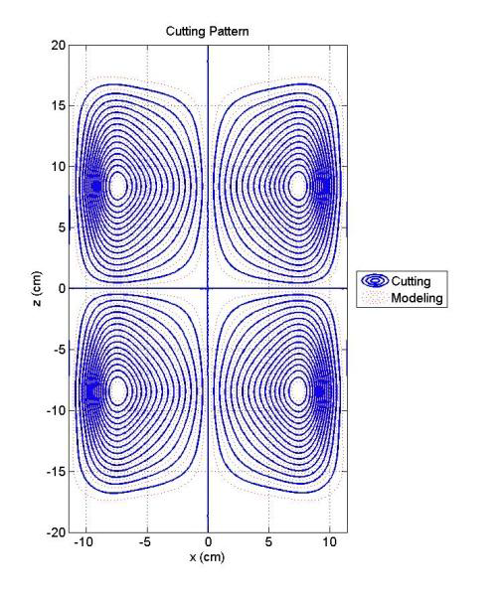
Stream function and contour plot

Slide 6
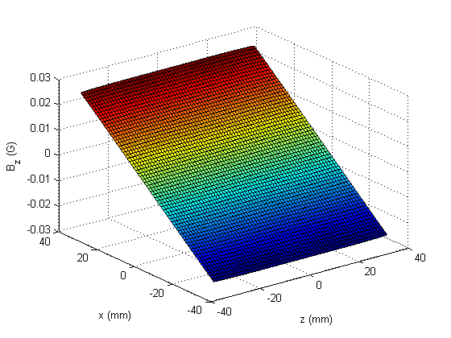
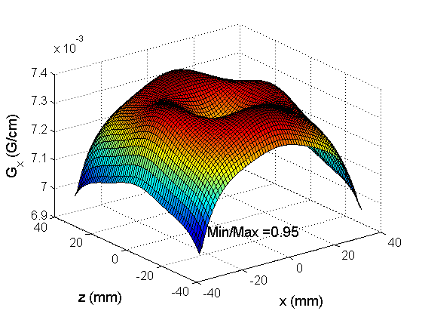
Actual Field
Field and gradient calculated by a Biot-Savart simulation of the arc segments of which the contour plot is composed. The number of arcs used was 41,056.

Slide 7
Workflow of the thesis code
Define the target field (T/m)
Define the ROI in which the field is calculated
Define the physical extent of the coil (m)
Define the area in which field should be linear
Calculate the target field distribution over the ROI including reversal
Compute fourier transform of target field to determine target current distribution
Apodize (filter) the freq space of target field to remove high spatial
Use FT of field to generate the FT of current density
Find stream function using current density
Generate cutting current pattern from stream function
Save the pattern
Input-Target field and Output-Wire Pattern
Input-Wire pattern and output-actual gradient field
simulation of actual field from the wire pattern generated based on Target field method
Points on which the field should be calculated is defined here
calculate the z-directed field at its x-grdaient

Slide 8
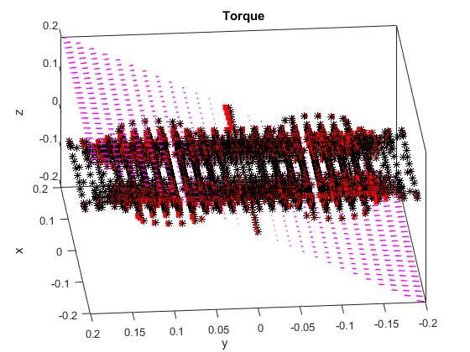
Torque and coil patterns

